Slide 1
WELCOME

Slide 2
Project tittle
TRASLINGUA : AI-POWERED MULTI-LANGUAGE TRANSLATOR
TEAM ID : LTVIP2026TMIDS49868
TEAM SIZE : 2
Team leader : Naga Sujana Ralii
Team member : Ramya Bontha

Slide 3
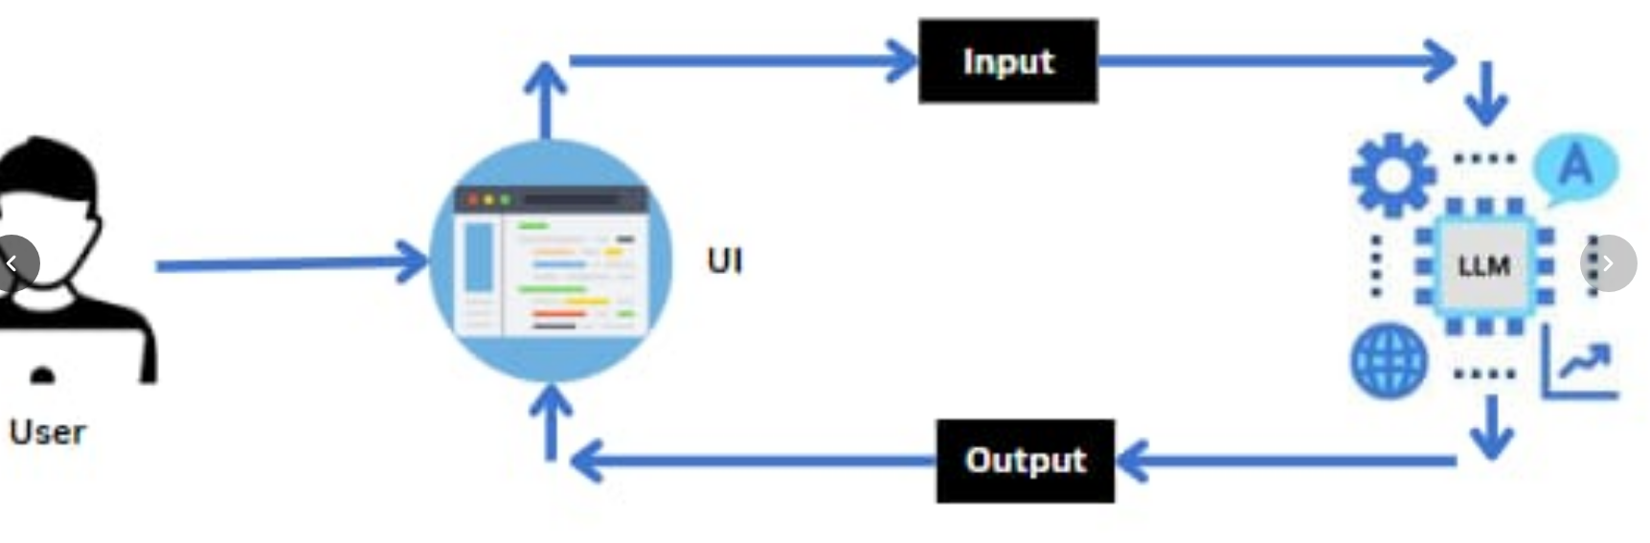
Architecture

Slide 4
Contents
WHAT IS translingua
Definition
Problem solution
feATURES
Advantages
Disadvantages

Slide 5
introduction
Google Cloud Generative AI Has Revolutionized Translation Services By Moving Beyond Traditional Machine Translation Into Ai-powered "Trans-lingua" Capabilities, Primarily Through Vertex AI And The Translation API. These Tools Leverage Large Language Models (Llms) To Understand Context, Tone, And Nuance Across Languages, Offering Higher-quality,, More Natural-sounding Translations Than Previous Methods.
What is a translingua ?
Translingua Revolutionizes Video Localization With Ai-powered Automation. Our Platform Combines Advanced Speech Recognition, Neural Machine Translation, And Natural Text-to-speech Synthesis To Deliver High-quality Localized Content In Minutes, Not Months

Slide 6
PROPOSAL SOLUTION
Google Cloud provides a generative AI proposal solution built on Vertex AI. It helps organizations develop, deploy, and manage AI-powered applications. This ecosystem includes models like Gemini, Imagen, Codey, and Chirp. It also has tools to customize and use these models with your own data.
Here is a structured proposal solution for implementing generative AI on Google Cloud:
Key Components of the Solution Vertex AI Platform: This unified AI platform builds, deploys, and scales machine learning models . from Google and partners, including Gemini .
Vertex AI Agent Builder: Simplifies the creation of conversational agents and search applications using Retrieval-Augmented Generation (RAG).
Vertex AI Studio: This tool tests and tunes prompts, allowing for rapid customization of models .Infrastructure: Optimized, secure, and scalable cloud infrastructure with GPUs (NVIDIA H100) .

Slide 7
features
TransLingua provides comprehensive AI-powered translation tools and professional services, integrating text, voice, and image capabilities to bridge language barriers. Key features include real-time speech recognition, image-based text extraction, text-to-speech, and specialized translation for legal, medical, and technical fields. Key Features of TransLingua (App/AI Tools)Text Translation: Supports fast, multi-lingual input for text, Apple .
Voice Translation: Provides instant voice recognition and translation, Apple .
Image Translation: Extracts and translates text from photos or uploaded images, Apple . Text-to-Speech: Enables audio output for better language learning and pronunciation , Apple.
AI Technology: Utilizes Neural Machine Translation (NMT) and Automated Speech Recognition (ASR)
Features: Features automatic history saving, one-tap sharing, and, in some version, offline translation modes.

Slide 8
ADVANTAGES
Based on the provided search results, Translingua (referring to the professional translation service provider) offers several advantages focused on high-quality, professional, and secure language services, particularly in specialized fields . Here are the key advantages of using Translingua:
High-Quality Human Translation Expert Linguists: Translingua works with highly qualified translators who generally translate only into their mother tongue, ensuring a natural and accurate feel . Four-Eye Principle: All texts are checked by professional editors/proofreaders to ensure accuracy. 2.Specialization: They provide experts in specific fields (legal, technical, medical, financial), ensuring accurate industry terminology . Contextual Accuracy: They go beyond word-for-word translation to adapt content for cultural context and tone, essential for marketing and business
Efficiency and TechnologyAI-Powered Tools (MTPE): Translingua combines AI-based machine translation with human post-editing (MTPE) to achieve faster delivery times and lower costs . Translation Memory: They use Translation Memory software to ensure consistent terminology and lower costs for repeated text . Quick Turnaround: They offer efficient project management for urgent, high-volume, or complex projects.

Slide 9
disAdvantages
Key Disadvantages Mentioned Include :
Resistance To Method: Students Or Teachers Accustomed To Strict "One Language Only" Policies May Find It Strange, Unnatural, Or Unprofessional .
Lack Of Experience/Unwillingness: Learners May Be Unwilling To Mix Languages If They Have Been Taught To Keep Them Strictly Separated, Requiring Encouragement To Use Their Full Repertoire .
Contextual Limitations: The Effectiveness Of Translanguaging Is Highly Dependent On The Educational Context (E.G., It Works Differently In Bilingual Classrooms In The USA Vs. Monolingual Contexts Like Poland).
Risk Of "English" Or Poor Habits: Over-dependence On Translation (A Form Of Translanguaging) Can Lead To Unnatural, Literal, Or Inaccurate Language ("English").
Missed Opportunities For Immersion: In Teaching Contexts, Skipping Direct, Immersive Communication In Favor Of Switching To A Native Language Can Hinder A Student's Ability To Learn To "Think" In The New Language.

Slide 10
conclusion
Best-of-Both-Worlds Approach: Google Cloud provides both Traditional NMT (best for low-latency, short, repetitive text) and Translation LLM (best for quality, nuances, and long content).
Enhanced Customization (Adaptive Translation): A key conclusion is that Generative AI allows for "Adaptive Translation," which can tailor output to a brand's unique voice and style in real-time with as few as five examples, achieving up to 23% higher quality in some scenarios .
Human-in-the-Loop: While Generative AI increases efficiency, it is not a complete replacement for human translators. The best results come from a "human-in-the-loop" approach, where AI handles the bulk of the work, and experts ensure quality, particularly for high-stakes or complex technical/legal content.
Superior Quality and Adaptability: Generative AI, particularly through Google's Translation LLM on Vertex AI, outperforms traditional Neural Machine Translation (NMT) in terms of fluency, context retention, and handling complex, long-form content .

Slide 11
THANK YOU

